Slide 1
NETWORK TOPOLOGY
GROUP 2

Slide 2
DEFINITION OF A NETWORK TOPOLOGY
A network topology is the arrangement of different elements like ( computers, servers, switches, and routers ) in a computer network.
A computer network is a group of interconnected computers and other devices that can communicate and share resources such as files, internet and applications.

Slide 3
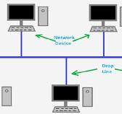
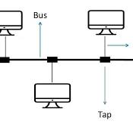
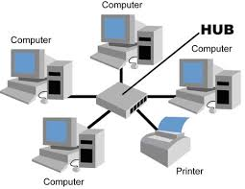
TYPES OF NETWORK TOPOLOGY
2. STAR TOPOLOGY
All devices are connected to a central hub or switch.
A hub is a network device used in star topology to connect multiple computers.
BUS TOPOLOGY
All devices are connected to a single central cable (BUS).

Slide 4
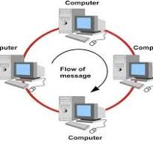
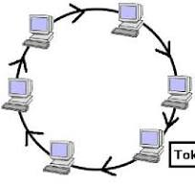
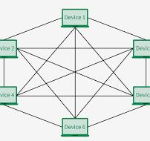
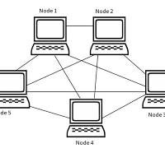
3. RING TOPOLOGY
In ring topology, devices are connected in a circular path.
4. MESH TOPOLOGY
In this topology every device connects to every other device.

Slide 5
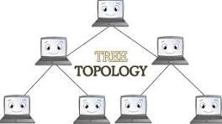
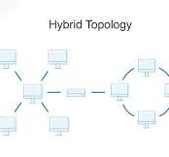
5. TREE TOPOLOGY
This is a combination of star and bus topologies in a hierarchical format.
6. HYBRID TOPOLOGY
This is a combination of two or more topologies.

Slide 6
For reference; https://youtu.be/uSKdjjw5zow?si=I2Upa3SgPWXCkX_2
GROUP MEMBERS
NAPASIRI JULIET
ABIKO RESTY
GALIWANGO HUSSEIN
OKIA EDWIN
AKAMPURIRA BENJAMIN

